Slide 2
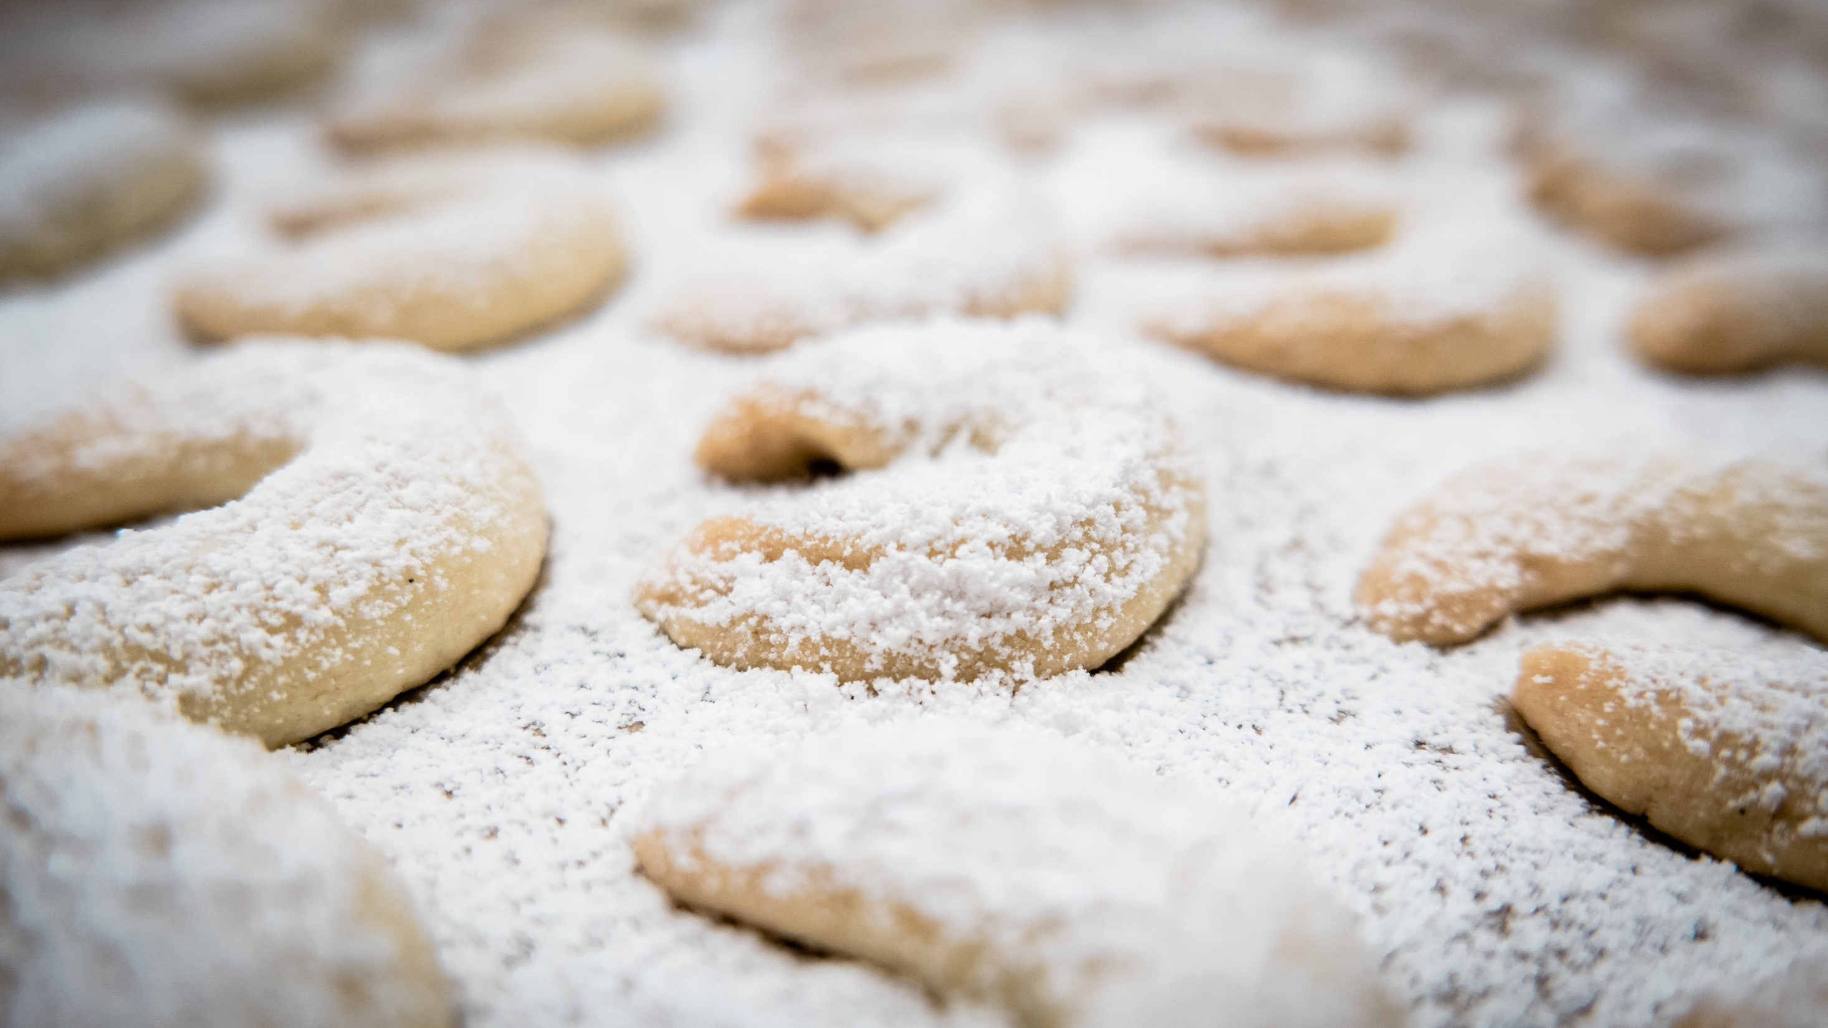
Vanilla Crescents with Marlene

Slide 3
Ingredients:
250g flour, and a little more for work surface
1tsp. Baking powder
125g sugar
1 vanilla extract
2 egg yolks
200g cold butter
125g ground almonds
50g icing sugar
4 sachets vanilla sugar

Slide 4
Method:
Mix flour and baking powder in a bowl, and add sugar, vanilla extract, egg yolk, butter and almonds and mix well with the dough hooks of the hand mixer
Knead the dough until smooth on a lightly floured work surface
Form rolls about the thickness of a pencil and place them on a large plate or baking tray and place in the fridge for about 30 minutes.
Once chilled, cut rolls into pieces about 4-5cm long and form them into croissants

Slide 5
Place them on a lined baking tray and Bake in a preheated oven at 180'C for approx. 10 mins
Mix icing sugar and vanilla sugar
Directly after baking, lightly sprinkle the sugar mixture on top of the still hot vanilla crescents
Once cooled, turn the vanilla crescents in the remaining mixture
Mahlzeit!

